Slide 1
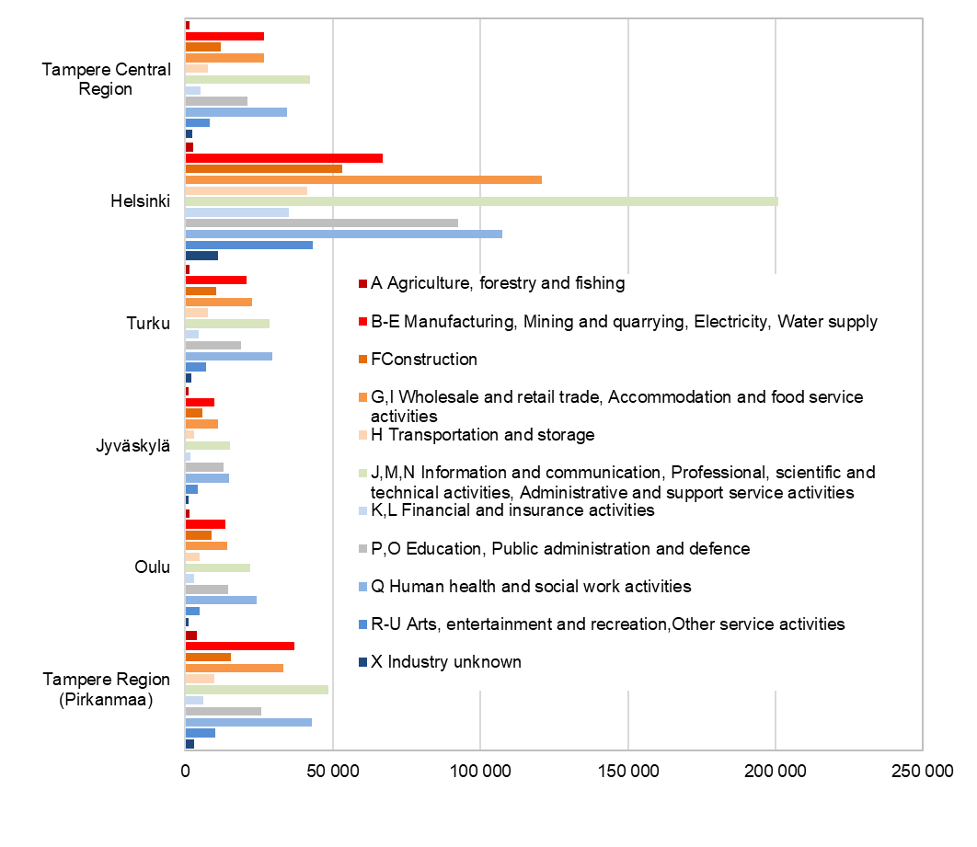
Employed persons by industry and sub-regional unit, 2022
SeutuNet
Standard Industrial Classification 2008
Source: Statistics Finland, Employment Statistics

