Slide 1
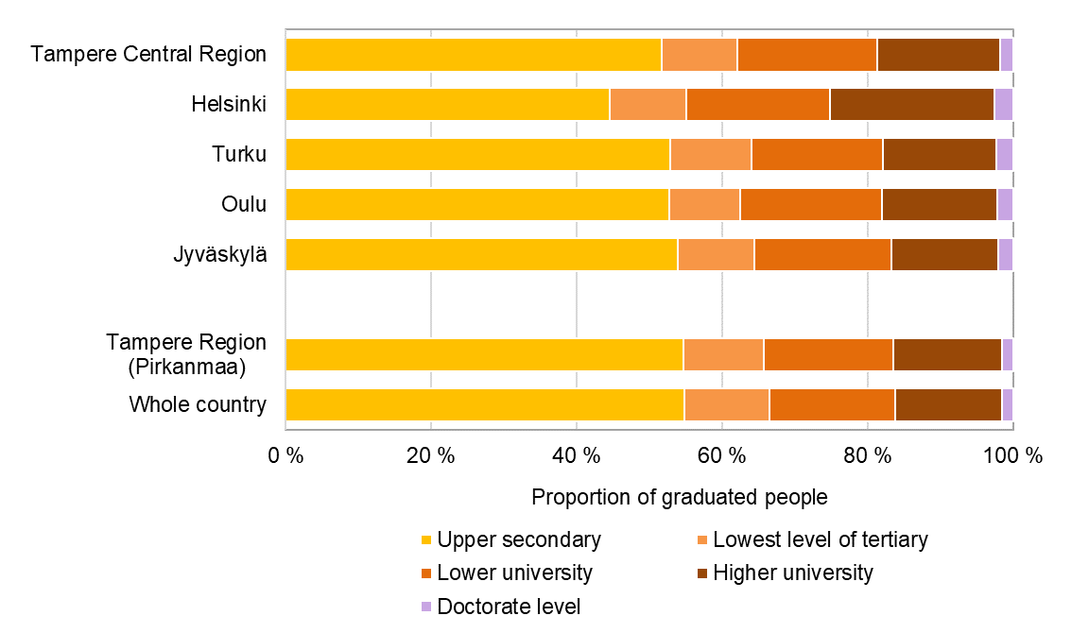
Population with educational qualification by sub-regional unit, 2022
Source: Statistics Finland/Education

