Slide 1
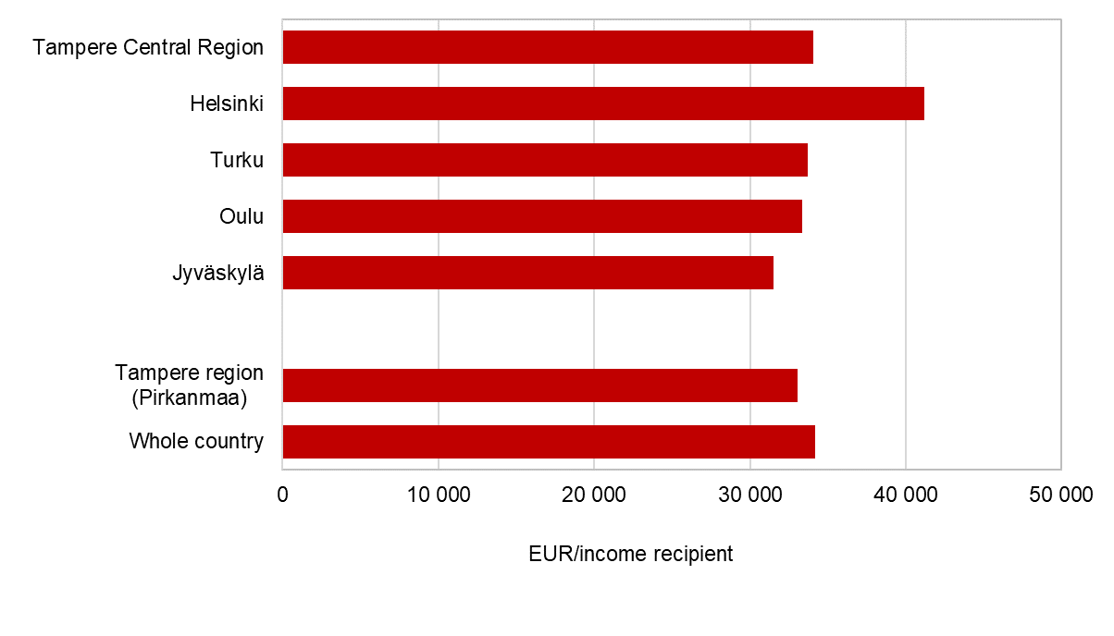
Income by sub-regional unit, 2021
Source: Statistics Finland

