Slide 1
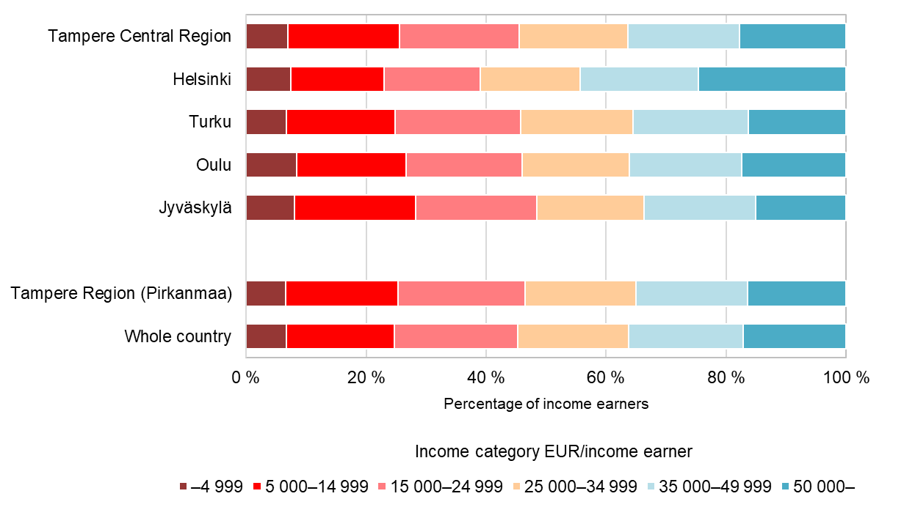
Income earners by income category and sub-regional unit, 2021
Source: Statistics Finland

