Slide 1
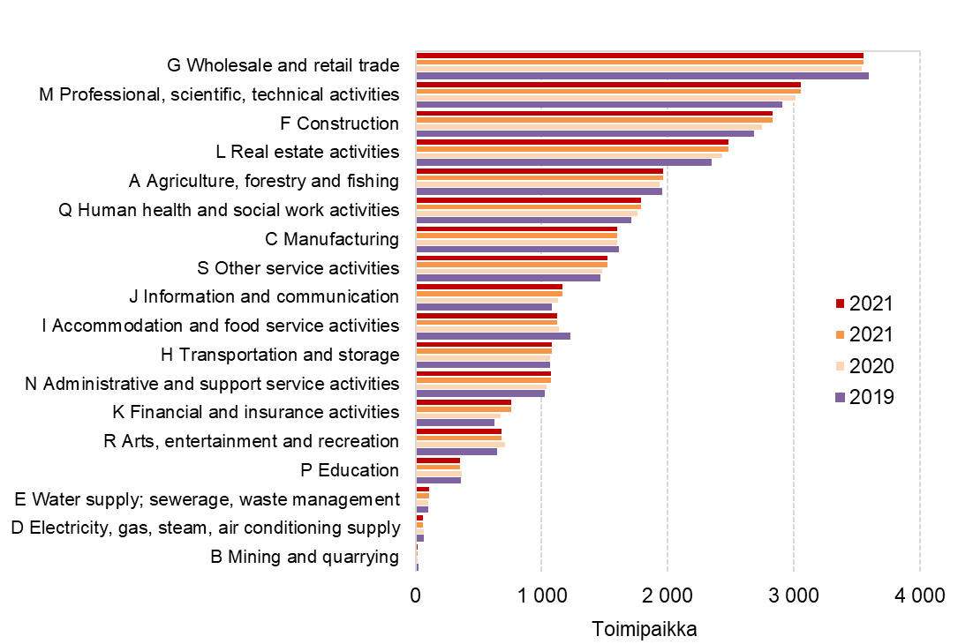
Establishments by industry in the Tampere Central Region, 2019–2021
Standard Industrial Classification 2008
Source: Statistics Finland, Business Statistics

