Slide 1
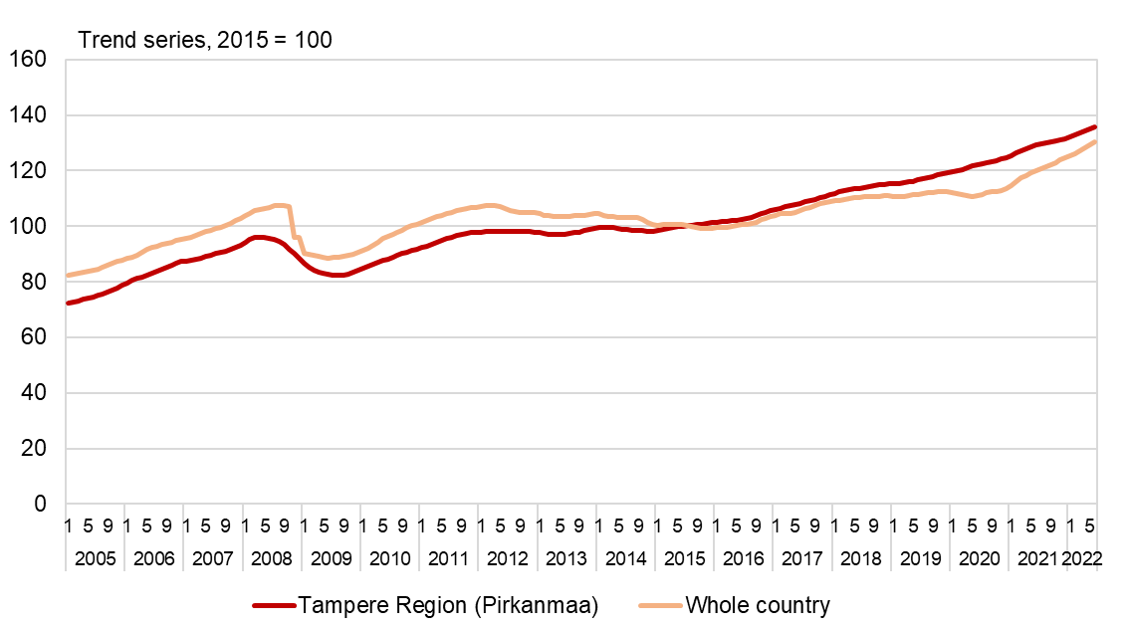
Turnover trends in wholesale and retail trade in the Tampere
Region (Pirkanmaa) and the whole country, 2005–2022
Source: Statistics Finland/Trend service for individual customers

