Slide 1
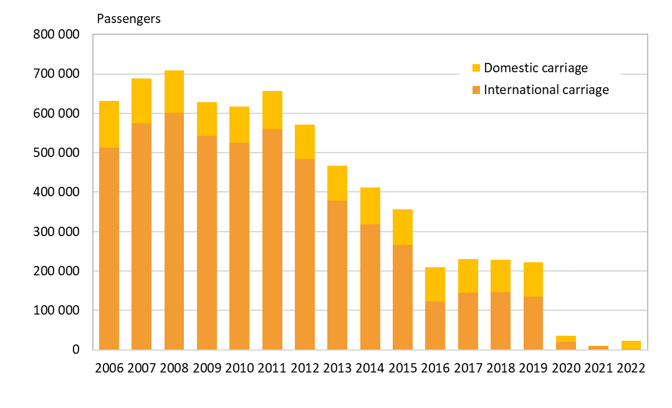
Number of passengers at Tampere airport, 2005–2022
SeutuNet
Source: Finavia

