Slide 1
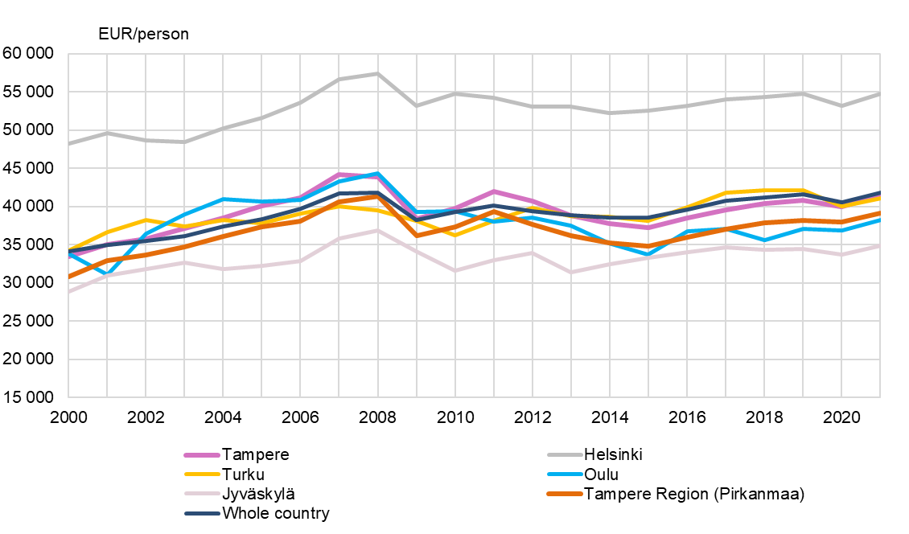
Gross domestic product per capita by sub-regional unit, 2000–2021
SeutuNet
Source: Statistics Finland

