Slide 1
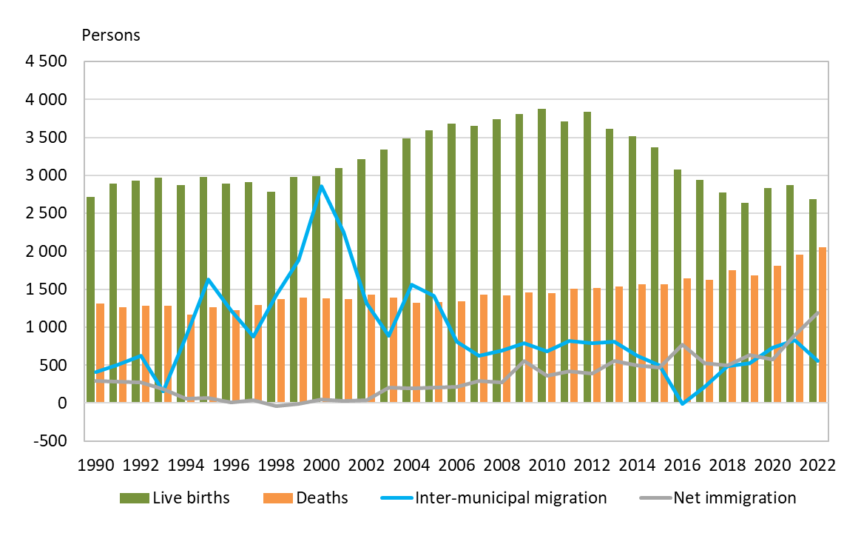
Population changes in the Oulu central region 1990–2022
Source: Statistics Finland

