Slide 1
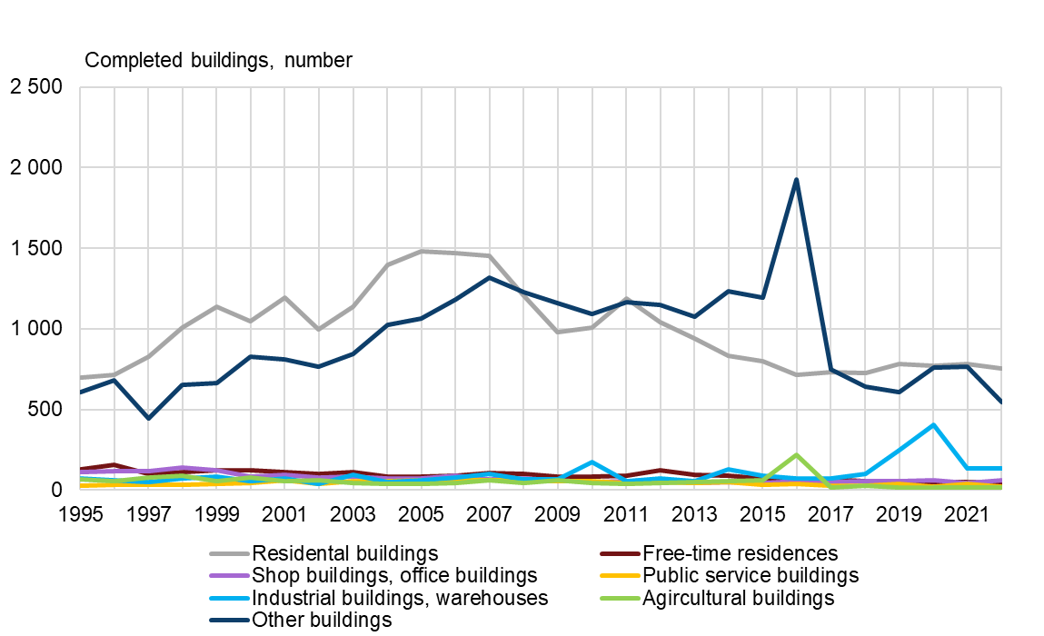
Building completions in the Oulu central region, 1995–2022*
*preliminary data
2023 regional boundaries
Source: Statistics Finland

