Slide 1
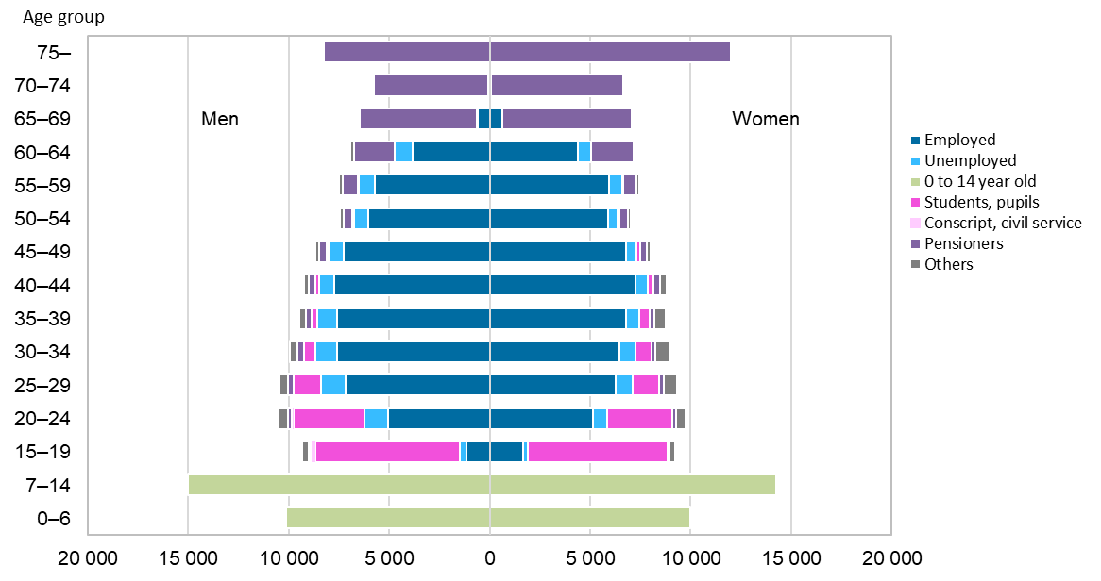
Population by activity in the Oulu central region, 2022
2023 regional boundaries
Source: Statistics Finland

