Slide 1
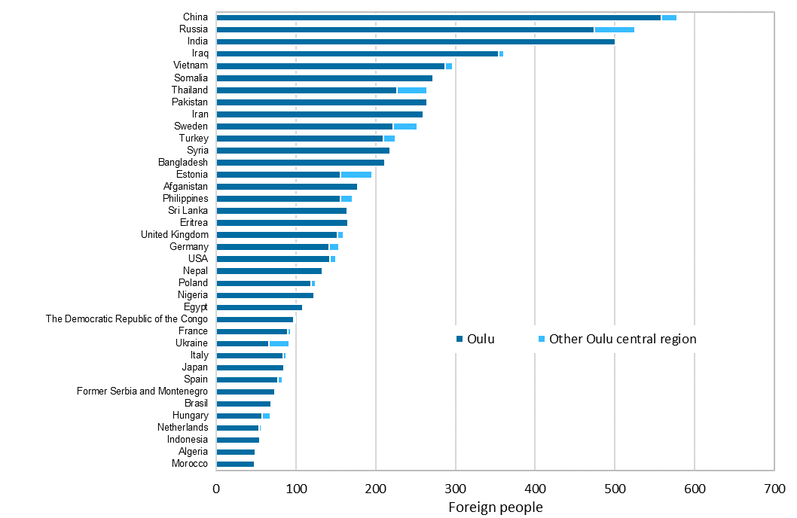
Largest groups of foreign nationals in the Oulu central region at end-2022
2023 regional boundaries
Source: Statistics Finland

