Slide 1
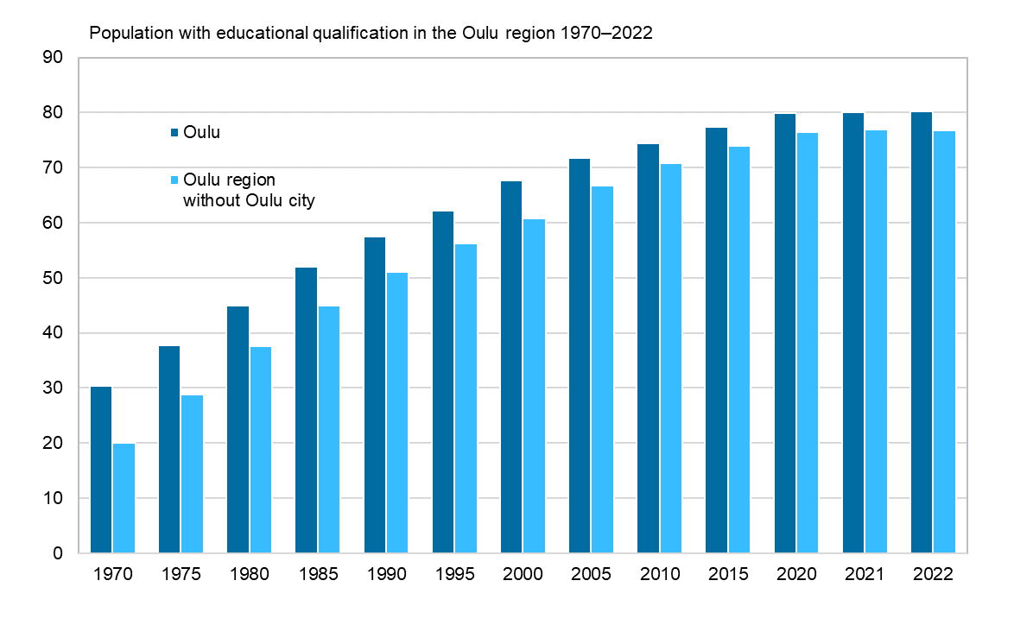
Population with educational qualification in the Oulu region 1970–2022
Source: Statistics Finland

