Slide 1
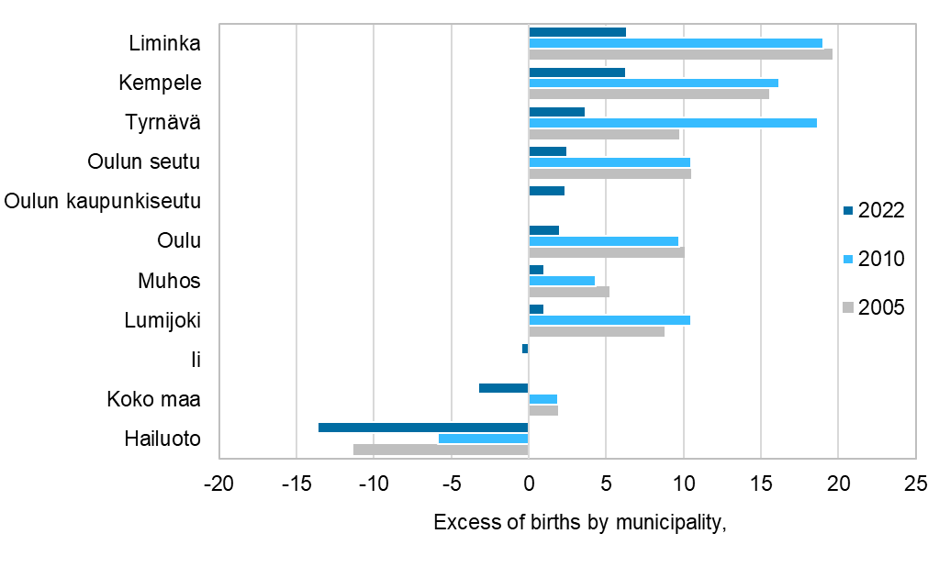
Excess of births by municipality, 2005, 2010 and 2022
Source: Statistics Finland

