Slide 1
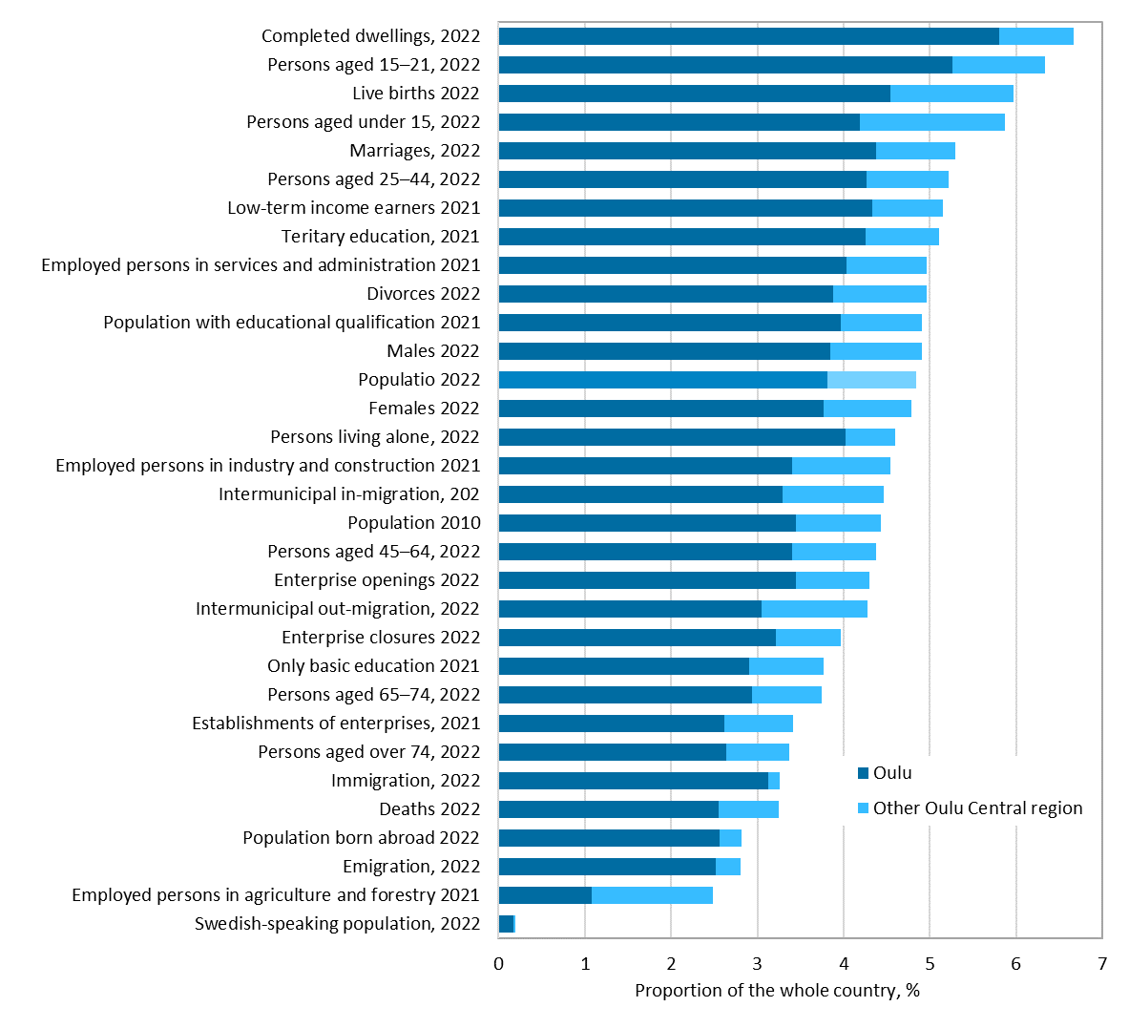
Profile of the Oulu central region
Source: Statistics Finland

