Slide 1
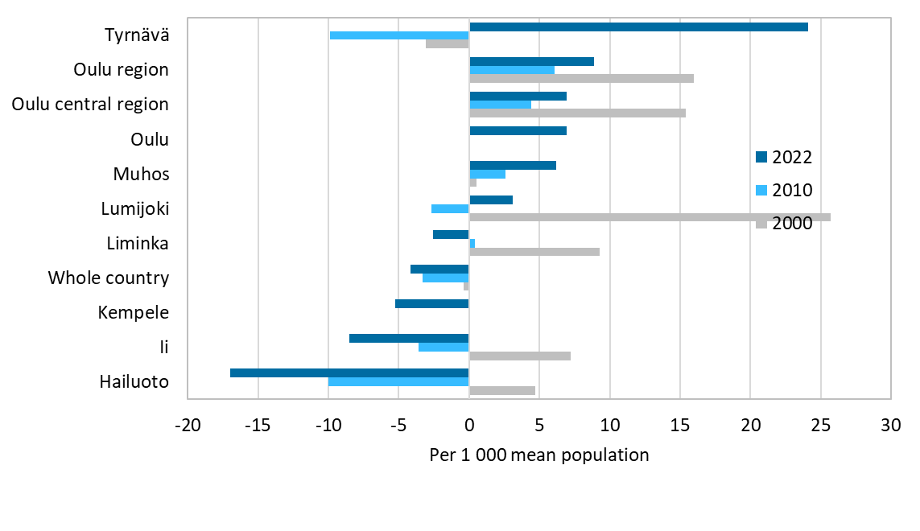
Total net migration by municipality, 2000–2022
Source: Statistics Finland

