Slide 1
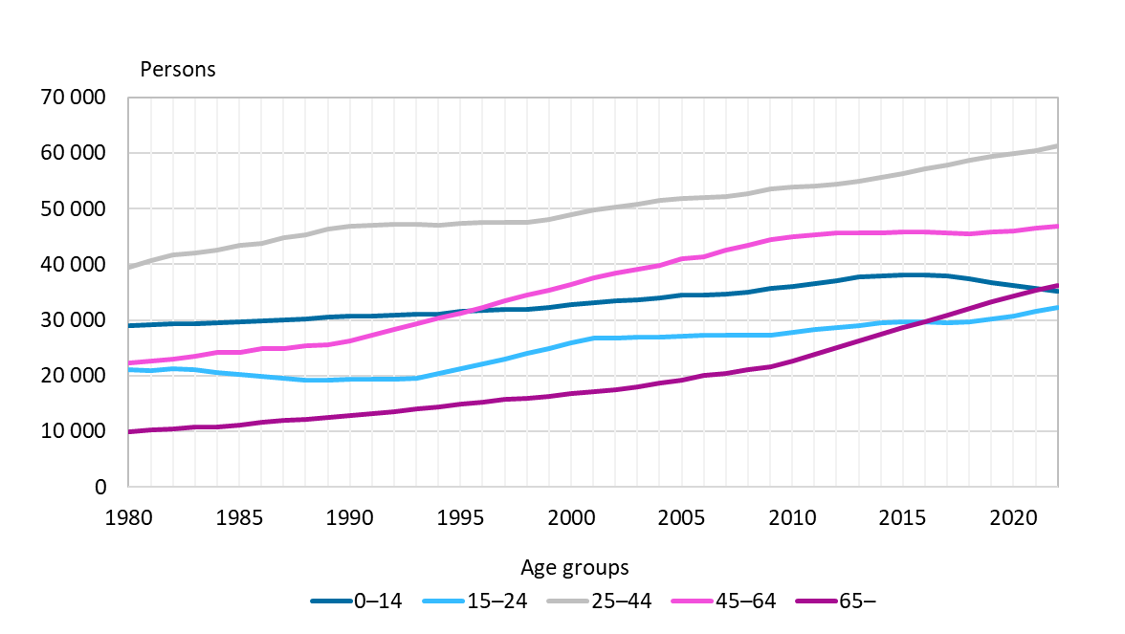
Population by age in Oulu, 1980–2022
Source: Statistics Finland

