Slide 1
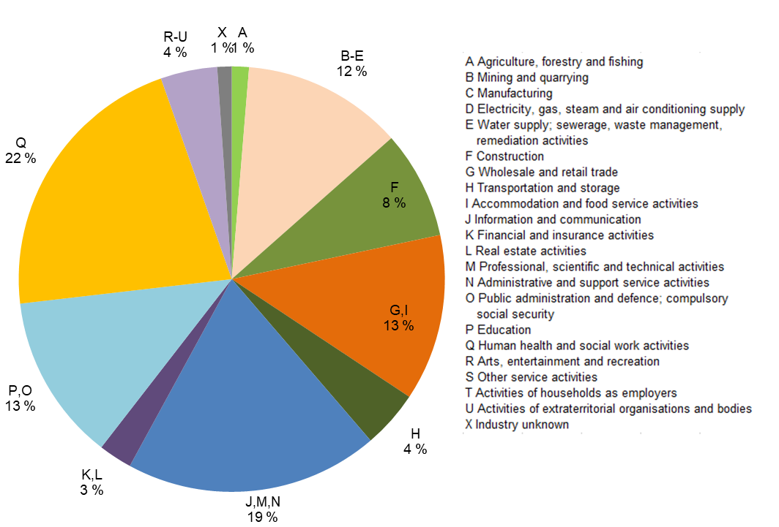
Employed persons by industry in the Oulu central region, 2022
Source: Statistics Finland

