Slide 1
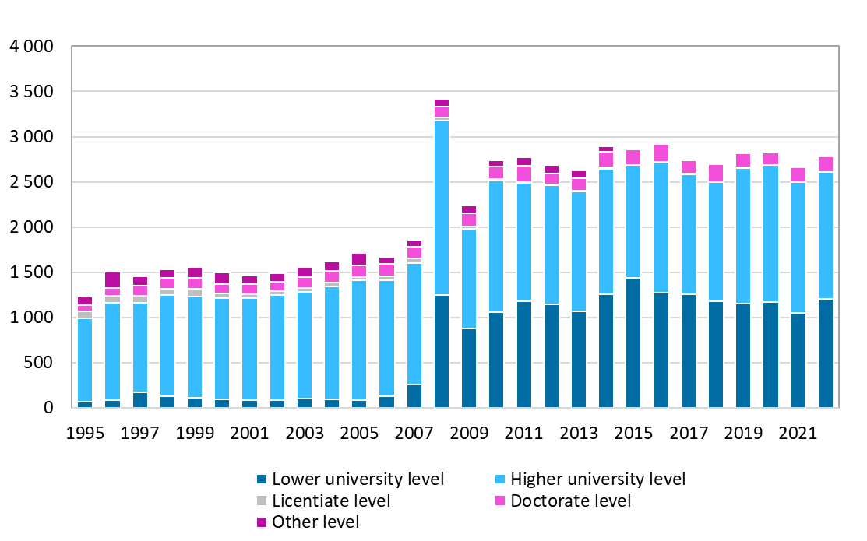
Degrees by level of education in the University of Oulu, 1995–2022
Source: Statistics Finland

